Slide 1
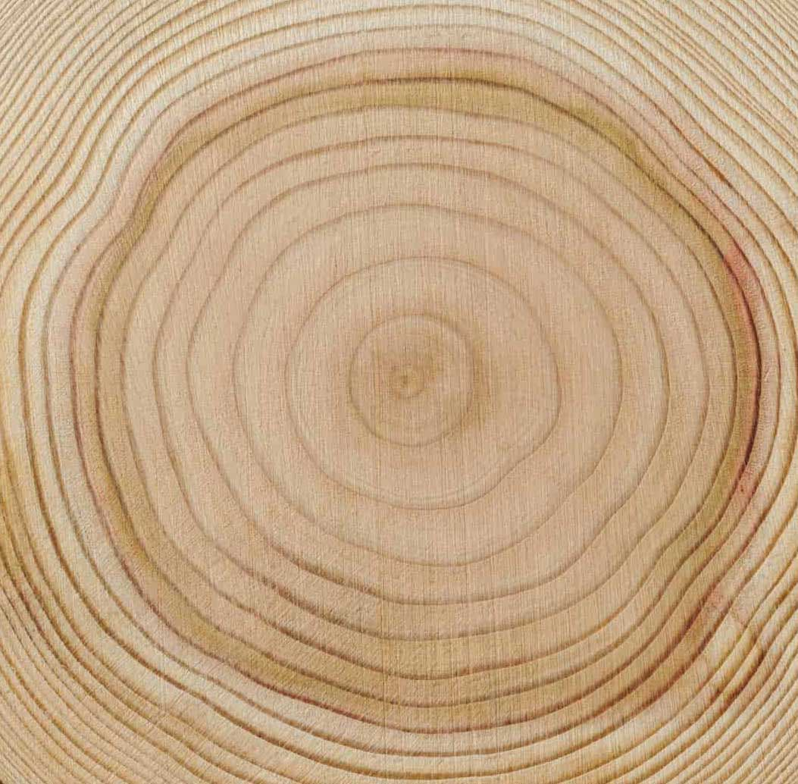
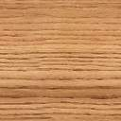
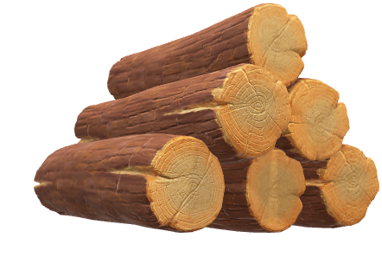
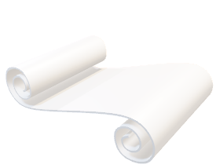
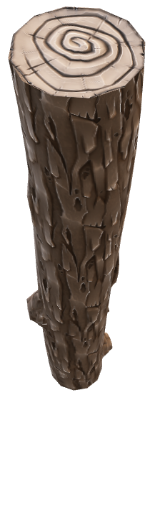

Miscellaneous Products
Softwood Plywood, Panels, Board
Utilization Rate: 81.3%
Paper
Bark
Lumber: Softwood & Hardwood
Log
Utilization Rate: Almost 100%

